Slide 1
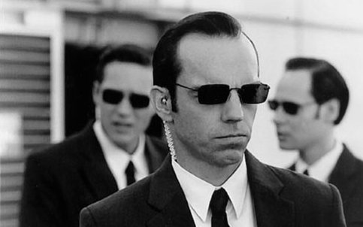
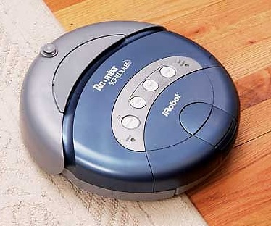
Chapter 2: Intelligent Agents

Slide 2
Outline
Last class, introduced AI and rational agent
Today’s class, focus on intelligent agents
Agent and environments
Video lecture available
Nature of environments influences agent design
Video lecture available
Basic “skeleton” agent designs
Review by yourself

Slide 3
Outline
Last class, introduced AI and rational agent
Today’s class, focus on intelligent agents
Agent and environments
Nature of environments influences agent design
Basic “skeleton” agent designs

Slide 4
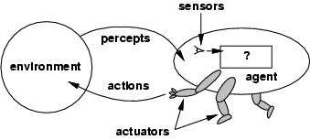
Agents
An agent is anything that can be viewed as perceiving its environment through sensors and acting upon that environment through actuators
Examples:
Human agent
Robotic agent
Software agent

Slide 5
Terminologies
Percept: the agent’s perceptual inputs
Percept sequence: the complete history of everything the agent has perceived
Agent function maps any given percept sequence to an action [f: p* → A]
The agent program runs on the physical architecture to produce f
Agent = architecture + program

Slide 6
Questions
Can there be more than one agent program that implements a given agent function?
Given a fixed machine architecture, does each agent program implement exactly one agent function?
Notes:
Yes, take any agent program and insert null statements that do not affect the output.
Yes, the agent’s behavior is fixed by the architecture and program

Slide 7
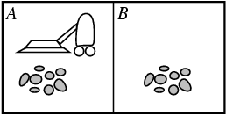
Vacuum-Cleaner World
Percepts: location and contents, e.g., [A, dirty]
Actions: Left, Right, Suck, NoOp

Slide 8
A Simple Agent Function
Percept sequence | Action
[A, Clean] | Right
[A, Dirty] | Suck
[B, Clean] | Left
[B, Dirty] | Suck
[A, Clean], [A, Clean] | Right
[A, Clean], [A, Dirty] | Suck
… | …
[A, Clean], [A, Clean], [A, Clean] | Right
[A, Clean], [A, Clean], [A, Dirty] | Suck
… | …
?

Slide 9
Rationality
An agent should "do the right thing", based on what it can perceive and the actions it can perform. The right action is the one that will cause the agent to be most successful
Performance measure: An objective criterion for success of an agent's behavior
Back to the vacuum-cleaner example
Amount of dirt cleaned within certain time
+1 credit for each clean square per unit time
General rule: measure what one wants rather than how one thinks the agent should behave

Slide 10
Rational Agent
Definition:
For each possible percept sequence, a rational agent should select an action that is expected to maximize its performance measure, given the evidence provided by the percept sequence and whatever built-in knowledge the agent has.

Slide 11
Rational Agent
Definition:
For each possible percept sequence, a rational agent should select an action that is expected to maximize its performance measure, given the evidence provided by the percept sequence and whatever built-in knowledge the agent has.

Slide 12
Vacuum–Cleaner Example
A simple agent that cleans a square if it is dirty and moves to the other square if not
Is it rational?
Assumption:
performance measure: 1 point for each clean square at each time step
environment is known a priori
actions = {left, right, suck, no-op}
agent is able to perceive the location and dirt in that location
Given different assumption, it might not be rational anymore

Slide 13
Omniscience, Learning and Autonomy
Distinction between rationality and omniscience
expected performance vs. actual performance
Agents can perform actions in order to modify future percepts so as to obtain useful information (information gathering, exploration)
An agent can also learn from what it perceives
An agent is autonomous if its behavior is determined by its own experience (with ability to learn and adapt)

Slide 14
In-Class Exercise #2.1
Given the assumption on slide 12. Describe a rational agent function for the modified performance measure that deducts one point for each movement. Does the agent program require internal state?
Discuss possible agent designs for the cases in which clean squares can become dirty and the geography of the environment is unknown.

Slide 15
Outline
Last class, introduced AI and rational agent
Today’s class, focus on intelligent agents
Agent and environments
Nature of environments influences agent design
Basic “skeleton” agent designs

Slide 16
PEAS
Specifying the task environment is always the first step in designing agent
PEAS:
Performance, Environment, Actuators, Sensors

Slide 17
Taxi Driver Example
Performance Measure | Environment | Actuators | Sensors
camera, sonar, speedometer, GPS, odometer, engine sensors, keyboard, accelerator
safe, fast, legal, comfortable trip, maximize profits
steering, accelerator, brake, signal, horn, display
roads, other traffic, pedestrians, customers
DARPA urban challenge 07: http://www.youtube.com/watch?v=SQFEmR50HAk

Slide 18

Medical Diagnosis System
Performance Measure | Environment | Actuators | Sensors
healthy patient, minimize costs, lawsuits | patient, hospital, staff | display questions, tests, diagnosis, treatments, referrals | keyboard entry of symptoms, findings, patient’s answers

Slide 19
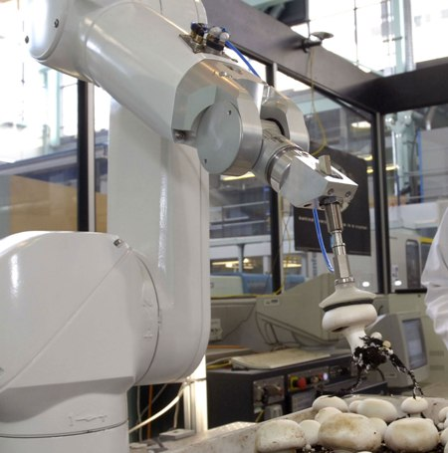
Mushroom-Picking Robot
Performance Measure | Environment | Actuators | Sensors
Percentage of good mushrooms in correct bins | Conveyor belt with mushrooms, bins | Jointed arm and hand | camera, joint angle sensors

Slide 20
Properties of Task Environments
Fully observable (vs. partially observable):
An agent's sensors give it access to the complete state of the environment at each point in time
Deterministic (vs. stochastic):
next state of the env. determined by current state and the agent’s action
If the environment is deterministic except for the actions of other agents, then the environment is strategic
Episodic (vs. sequential):
Agent's experience is divided into atomic "episodes"
Choice of action in each episode depends only on the episode itself

Slide 21
Properties of Task Environments
Static (vs. dynamic):
The environment is unchanged while an agent is deliberating
Semidynamic if the environment itself doesn’t change with time but the agent's performance score does
Discrete (vs. continuous):
A limited number of distinct, clearly defined percepts and actions
Single agent (vs. multiagent):
An agent operating by itself in an environment
Competitive vs. cooperative

Slide 22
Examples
Task Environment | Oberservable | Deterministic | Episodic | Static | Discrete | Agents
Crossword puzzle
Chess with a clock
Taxi driver
mushroom-picking
fully deterministic sequential static discrete single
fully strategic sequential semi discrete multi
partially stochastic sequential dynamic conti. multi
partially stochastic episodic dynamic conti. single
The environment type largely determines the agent design
The real world is (of course) partially observable, stochastic, sequential, dynamic, continuous, multi-agent

Slide 23
In-Class Exercise #2.2
Develop PEAS description for the following task environment:
Robot soccer player
Shopping for used AI books on the Internet
Analyze the properties of the above environments

Slide 24
In-Class Exercise #3: True/False Questions
1. An agent that senses only partial information about the state cannot be perfectly rational.
2. Suppose an agent selects its action uniformly at random from the set of possible actions. There exists a deterministic task environment in which this agent is rational.
3. It is possible for a given agent to be perfectly rational in two distinct task environments.
4. A perfectly rational poker-playing agent never loses.

Slide 25
Outline
Last class, introduced AI and rational agent
Today’s class, focus on intelligent agents
Agent and environments
Nature of environments influences agent design
Basic “skeleton” agent designs

Slide 26
Agent = Architecture + Program
The job of AI is to design the agent program that implements the agent function mapping percepts to actions
Aim: find a way to implement the rational agent function concisely
Same skeleton for agent program: it takes the current percept as input from the sensors and returns an action to the actuators

Slide 27
Agent Program vs. Agent Function
Agent program takes the current percept as input
Nothing is available from the environment
Agent function takes the entire percept history
To do this, remember all the percepts

Slide 28
Table-Driven Agent
Designer needs to construct a table that contains the appropriate action for every possible percept sequence
Drawbacks?
huge table
take a long time to construct such a table
no autonomy
Even with learning, need a long time to learn the table entries

Slide 29
Five Basic Agent Types
Arranged in order of increasing generality:
Simple reflex agents
Model-based reflex agents
Goal-based agents
Utility-based agents; and
Learning agents

Slide 30
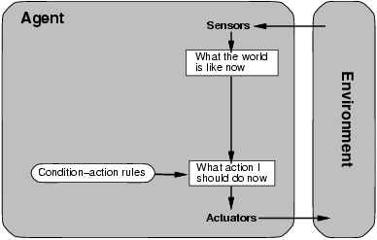
Simple Reflex Agent

Slide 31
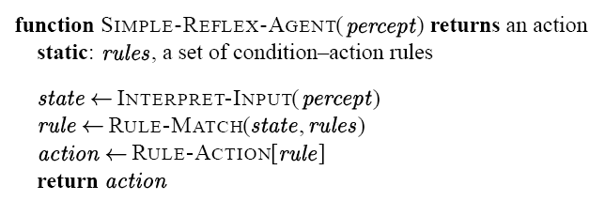
Pseudo-Code
Example: write a simple reflex agent for the vacuum cleaner example

Slide 32
Infinite loops are often unavoidable for simple reflex agent operating in partially observable environments
No location sensor
Randomization will help
A randomized simple relfex agent might outperform a deterministic simple reflex agent
Better way: keep track of the part of the world it can’t see now
Maintain internal states

Slide 33
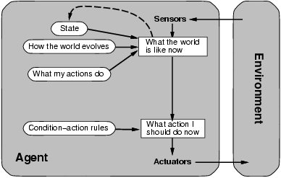
Model-Based Reflex Agent

Slide 34
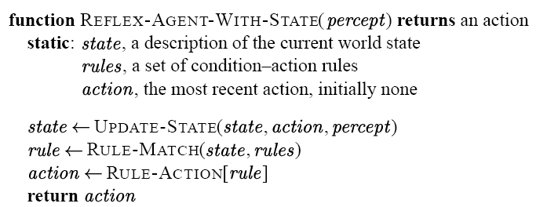
Pseudo-Code

Slide 35
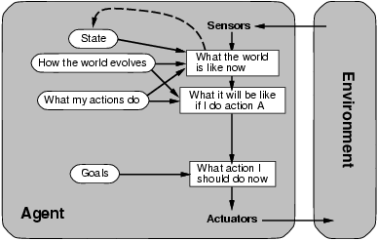
Goal-Based Agent

Slide 36
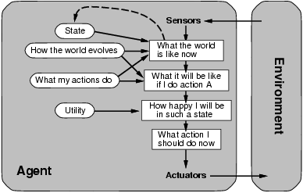
Utility-Based Agent

Slide 37
Utility Function
Utility function maps a state or a sequence of states onto a real number → degree of happiness
Conflicting goals
Speed and safety
Multiple goals

Slide 38
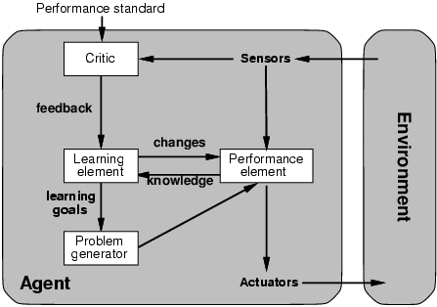
Learning Agent
Determines
performance
Selects the
Best action
Making
improvements
Suggest
exploratory
actions

Slide 39
Thinking Exercise
Select a suitable agent design for:
Robot soccer player
Shopping for used AI books on the Internet

Slide 40
Summary
Agent, agent function, agent program
Rational agent and its performance measure
PEAS
Five major agent program skeletons
Next, solving problems by searching

